Slide 1

Pricing the LED Bulbs Case studies - Philips

Slide 2
Context: Philips is launching a new premium lightening product - LED bulbs and faces some difficulties in pricing products, targeting customers and selecting the channels
Context: new product launch and LED market analysis
Problems: how much to sell, who should target and where to sell
Philips launched a high premium lightening product – LED bulbs (price is 6x of a compact fluorescent light bulb and 40x of a standard white incandescent bulbs)
LED bulb is a very new/innovative product in the lightening market which only takes up <1% market share compared with 61% of Incandescent light bulbs
How much should Philips price?
How do Philips increase consumer awareness on this high premium LED product? (ex: focus on environmentally friendly or cost saving)
Whom to target? (Individual customers or business customers)
What channel to sell the products? (Retailer vs Distributions)

Slide 3
Summary: Philips can price LED bulbs at $22 and launch powerful ads and educate programs to boost the market demand to benefit from the potential LED bulbs market
Market analysis
3 main market players in lightening industries in north American
LED bulbs only have <1% market share
Product positioning
LED bulbs have 2 main advantages – cost saving and environmentally friendly
LED bulbs have 2 main drawbacks – high product cost and retail price which discourages customer on purchasing
Pricing strategy
Setting price above marginal cost $9 to at least breakeven the business
Possibly to sell the product at the highest market cap $23 since LED bulbs product can save ~$150 for customers
Re-negotiate the retail margin with our business partners
Recommendations
Launching powerful advertisements and educate programs
Develop low cost products with lower product specifications

Slide 4
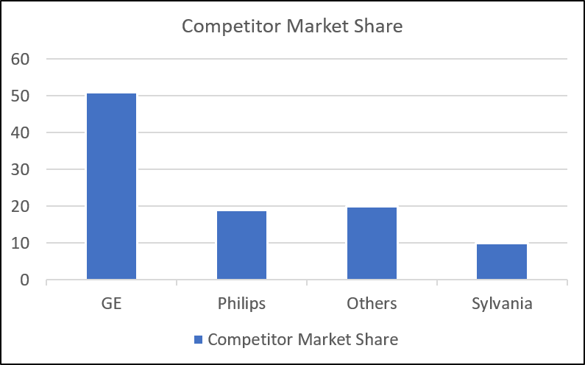
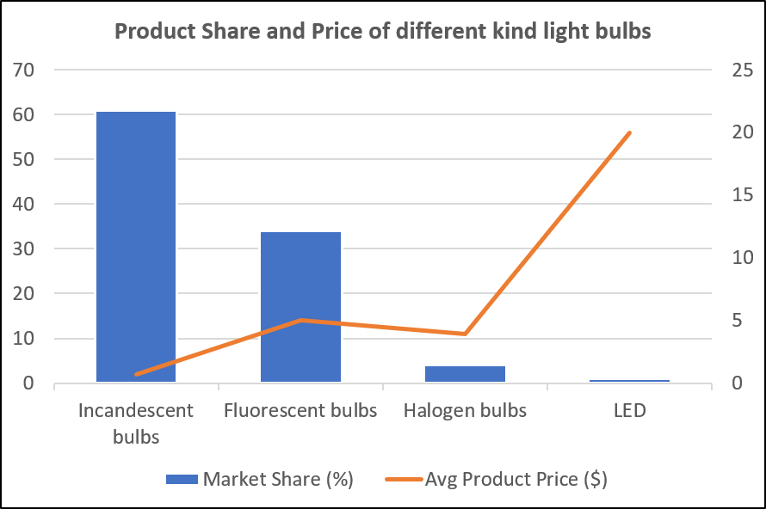
Market Analysis: 3 main players in lightening market and incandescent and fluorescent bulbs consist of 95% of the market
3 main players in lightening market – GE, Philips and Sylvania
GE is the market leader with 51% of market shares followed by Philips with 19% of market share
3 main channels to sell the light bulbs – supermarket, discounters, wholesale clubs
Incandescent and fluorescent bulbs make up 95% of the lightening market
Price of a LED bulb is ~33x higher of a incandescent bulb, ~4x higher of a fluorescent bulb and ~5x higher of a halogen bulb
Product market share and price seems to have a negative relationship, says the higher the product price, the less market share

Slide 5
Product Positioning: LED bulbs has 2 main selling points but with 2 major issues that need to be discussed when pricing the products
Customer perspectives: cost advantage, eco- friendly
Philips perspectives: having first mover advantage but with some points need to be considered
Cost advantage of using LED bulbs
Individual and business customers can save at least *$150 and $128 electricity bills respectively even though a LED bulb charge 40x of a standard white incandescent bulb
LED bulbs is more energy efficient (saving 8x energy) and has longer life expectancy (24x longer)
Customer utility
Customer utility increase from -9.2 to 6.1 if the energy usage of the bulb reduces from 25 watt to 10 watt
Eco-friendly attitude: using this product can save our planet
LED bulbs comparative advantages
First mover advantage: launch the first LED bulbs among 3 main market players
Energy saving and longer life expectancy -> reduce electricity cost & is eco-friendly
LED bulbs disadvantages
High product cost ($4) -> 45x of a standard incandescent bulb
High retail price (~$20) -> 40x of normal bulb
Customer takes more time to make purchasing decisions -> low turnover rate for our business partners
High retail margin ~55% of retail price needs to be paid to compensate for our low product turnover rate
*Assume using 18000 hours with electricity fee $12.7 cents/kwh
-Bills of using soft white incandescent bulbs: 75 watt* 18000* 12.7/100000 = 171.45 (bulbs fee: 18000*0.6/750=14.4
-Bills of using LED bulbs: 9 watt* 18000* 12.7/100000 = 20.57 (bulb fee ~20)

Slide 6
Pricing Strategy and Recommendations: Philips can price their products between $9 and $23 and take some measures to create more market demand for LED bulbs
Pricing setting: retail price range from $9 to $160 and possibly reduce retail margin
Recommendations: launching ads and educate programs and develop cheaper products with lower product specifications
Breakeven price: *$9
Retail price setting
since customers can save at least $150 electricity bills, we can price our products somewhere between $9 and $160
Retail margin setting
currently the retail margin is 55% because of higher product cost and low product turnover rate -> should enhance our marketing strategies and educate our customers about the benefit of changing their conventional bulbs to LED bulbs -> increase market demand and re-negotiate the retail margin
Philips has first mover advantages in terms of launching LED bulbs – possibly can increase the product price above marginal cost $9 to $22 or $23 (since the highest LED bulb price in that market is around $23)
Launching powerful advertisements and educate programs
promote the benefits of using LED bulbs to boost market demand -> big potential since currently LED bulbs only have <1% market share
Develop low cost products with lower product specifications
acquire more market and increase product turnover rate
*Assume retail margin is 55%, product cost is 4 and retail price is x
-0.45x>=4 -> x>=8.88

Slide 7
Original pic

